Slide 1
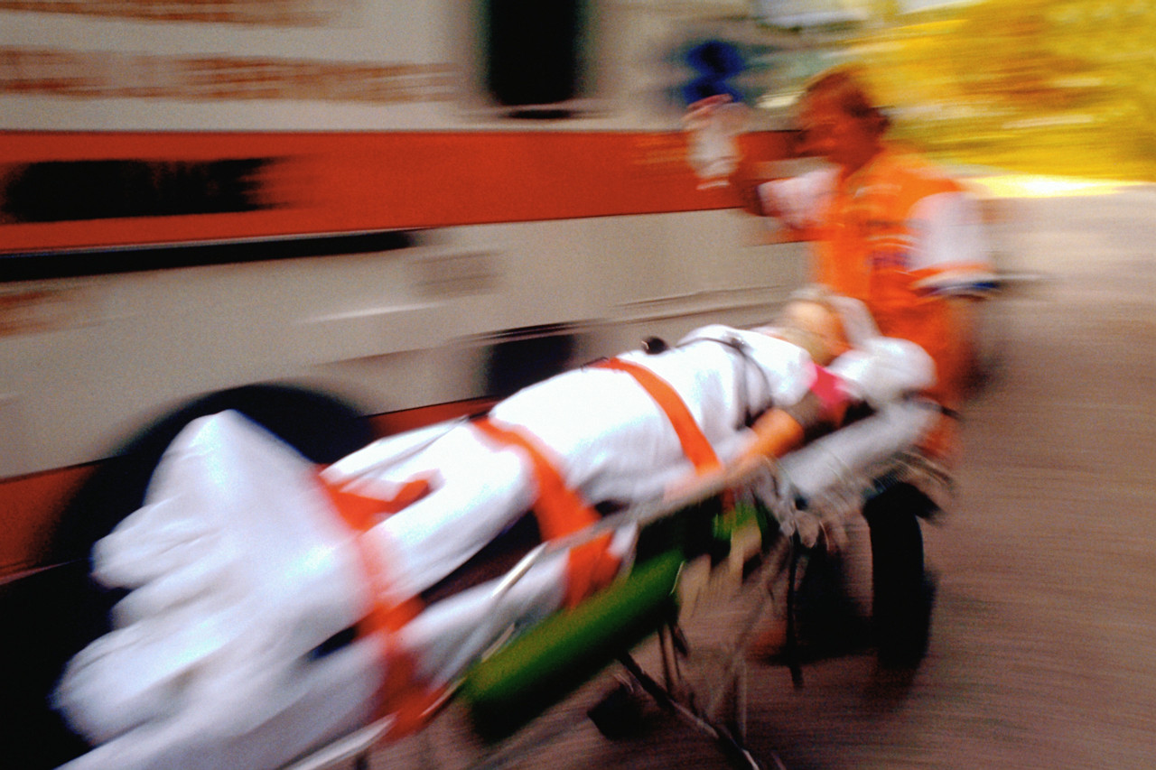
medical and fire emergencies
Thomas Pechal, Sgt.Wilkinson, and Jeff Fritz

Slide 2
Scenario 1
You are teaching on the third floor (AC or Hutto)
Students begin to smell smoke
You open the door to find the hallway filled with thick smoke at shoulder level.
BTW, you have a student who is in a wheelchair in your class.
What should you do?

Slide 3
Scenario 2
You are teaching in the AC or Hutto.
You notice a student who turns pale and begins to perspire. When you ask if he is alright, states that he has chest pain.
As you are deciding what you to do, he suddenly collapses in his chair.
What should you do?

Slide 4
Common Problems
Syncope
Seizure
Allergic reaction
Heart disease
Sudden Cardiac Arrest
Asthma/Respiratory
Diabetes
Chocking
Anxiety
Fall
Bleeding

Slide 5
Common Problems at TC
Trauma
Seizure
Syncope/Weakness
Chest Pain

Slide 6
Mitigation
CPR Course
Location of tools
  AED
  First Aid kits
  Fire Extinguishers
Being aware of surroundings
Reviewing plans on a regular basis
Notes:
Don’t stop believn – Journey
I will survive – diana Ross
Don’t Stop till you get enough – Michael Jackson

Slide 7
Resources during an event
911
Students
TC Police
First Aid Kits
SDS Sheets

Slide 8
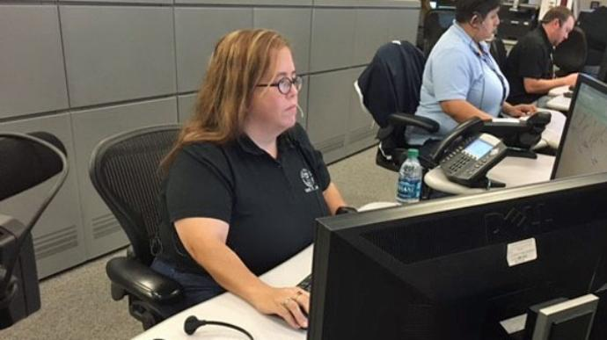
911 Information
Name and number
Location of problem
Best path

Slide 9
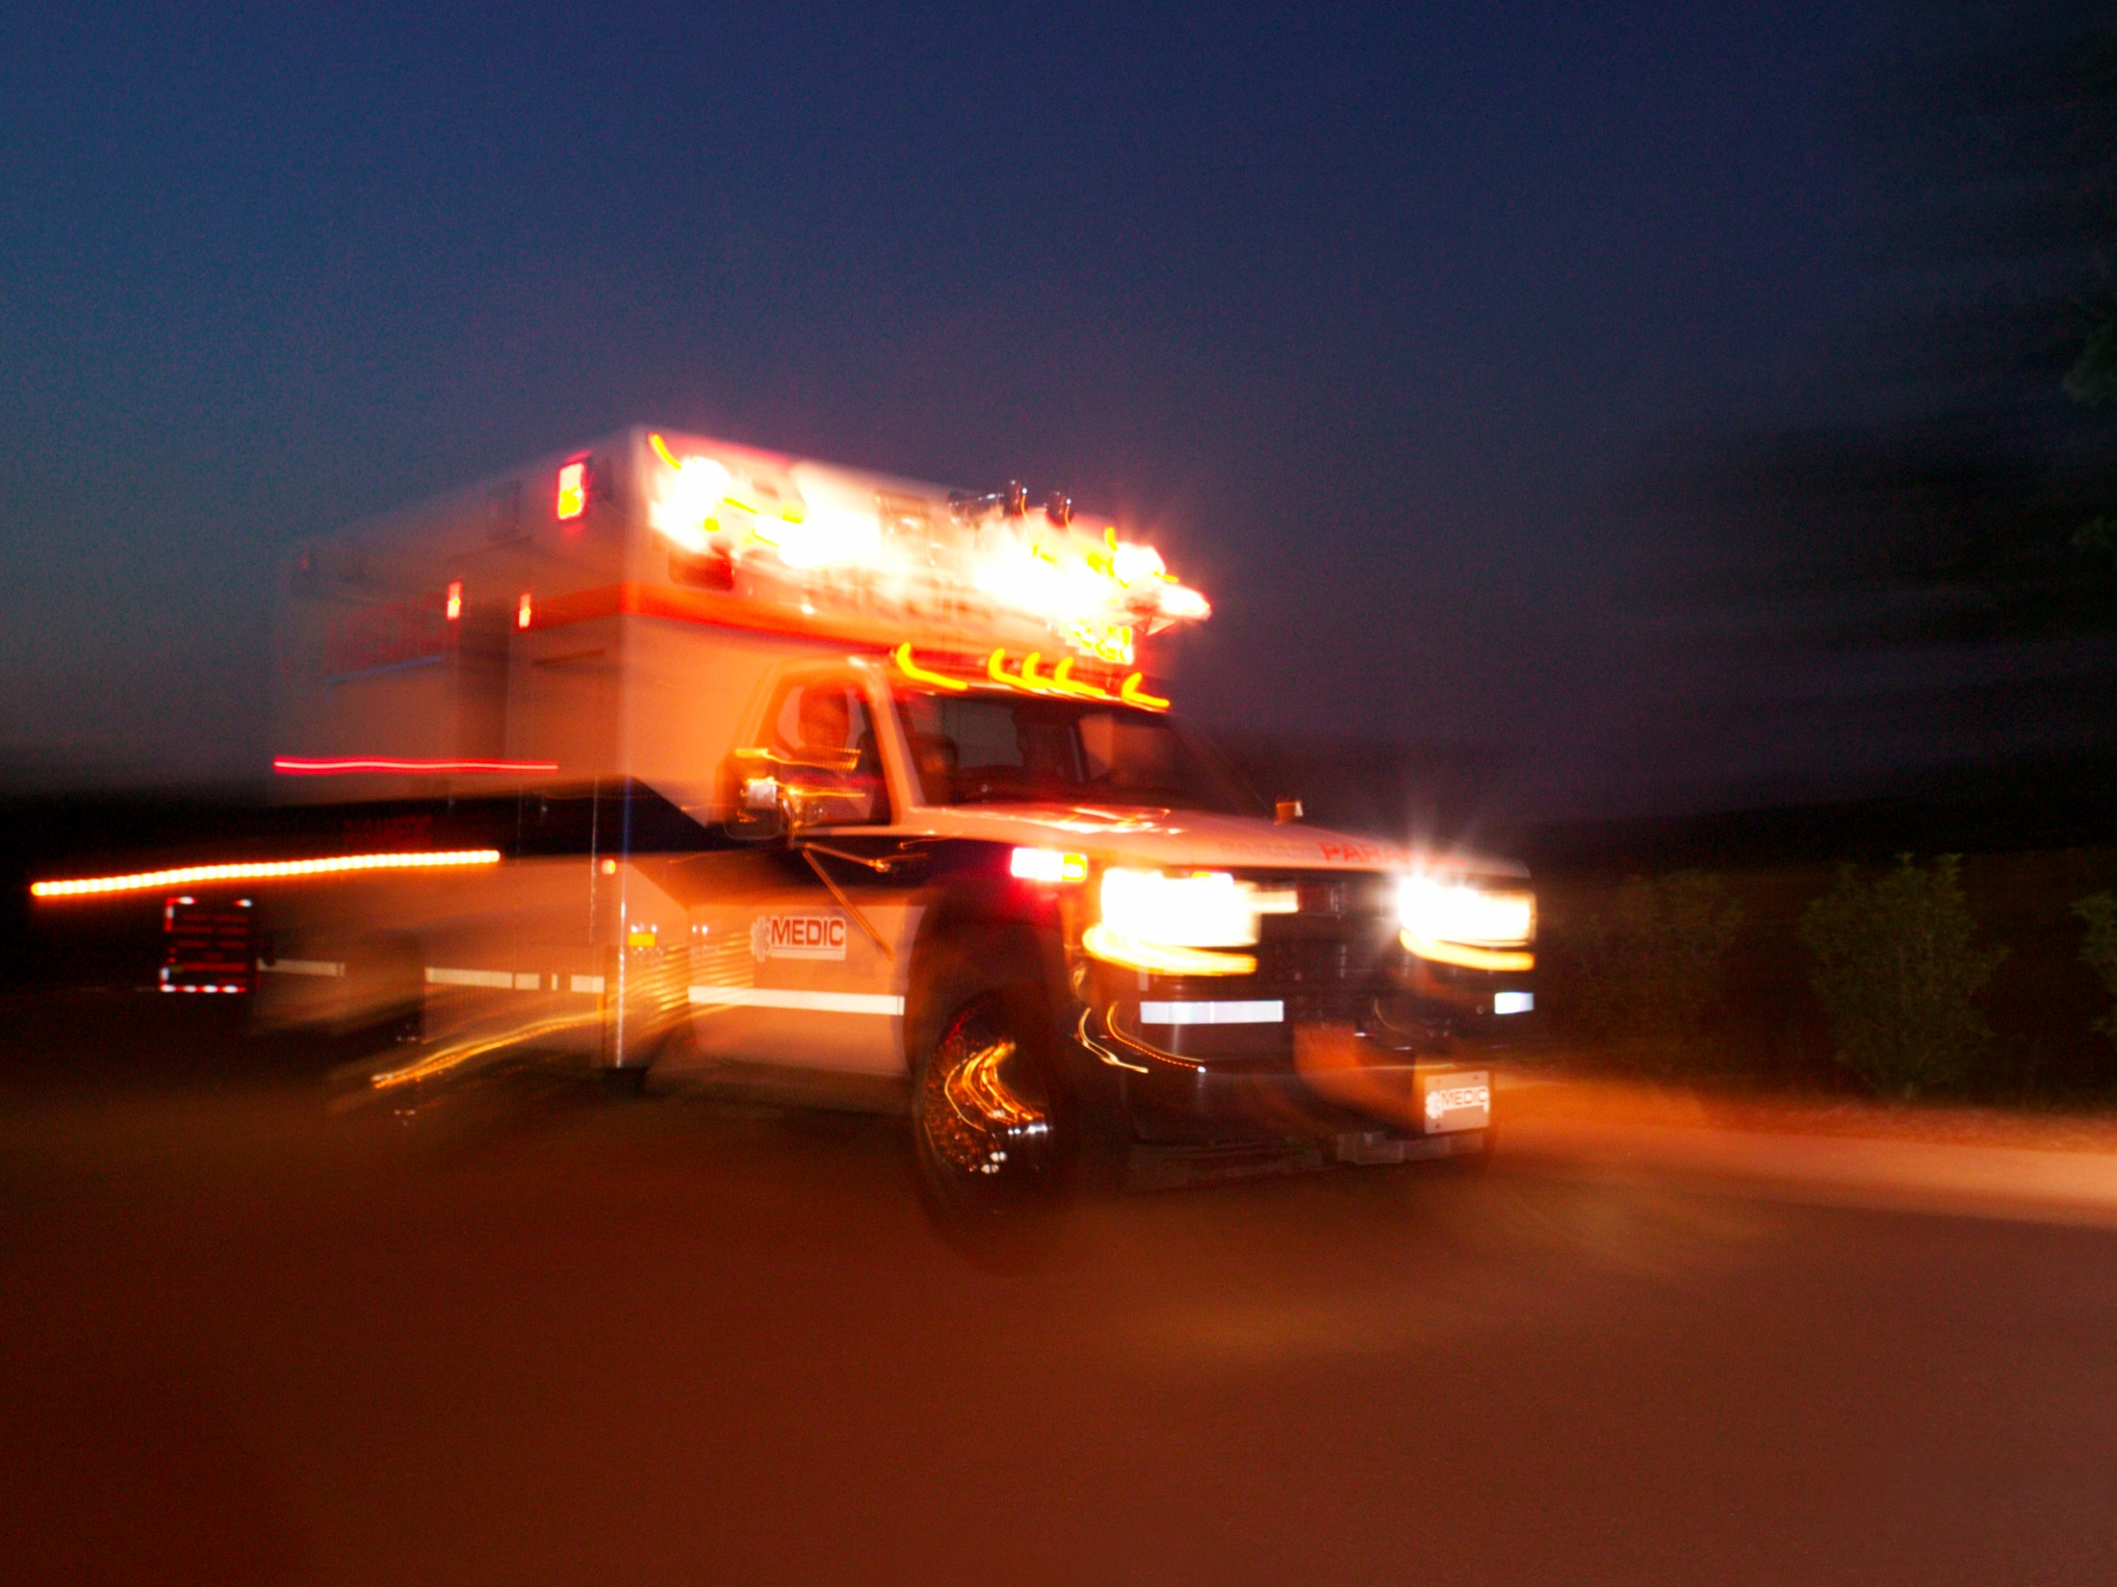
Response
Remain calm
Ask for help
Send student to retrieve AED/First Aid kit
Call 911/TC Police
Send a student to meet fire and EMS
Clear area/provide privacy for patient

Slide 10
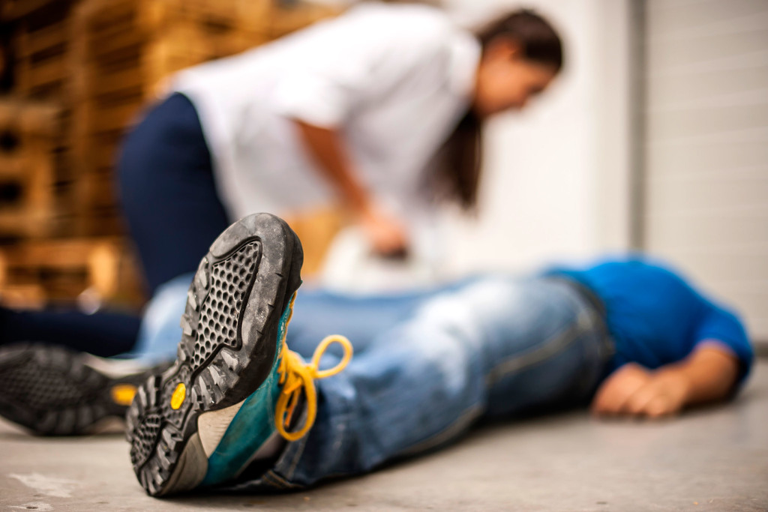
While help is coming
Protect yourself
Place patient in position of comfort
Talk to the person
Monitor breathing

Slide 11
Difficulty Breathing
Encourage to stop and sit down
Place patient in position of comfort
Encourage them to take their medicine (if appropriate)

Slide 12
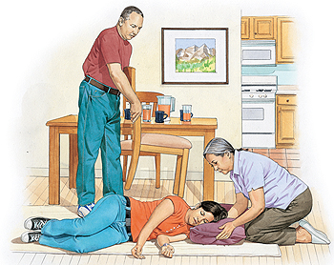
Seizure
Remove patient from chair
Lay patient flat
Move furniture away from patient
Protect patient from injuring themselves

Slide 13
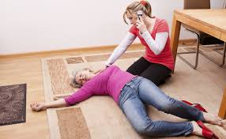
Fainting, Weakness or Fall
Check to see if they are injured
Place patient in a position of comfort
Encourage them to move slowly
If unable to get up, call 911

Slide 14
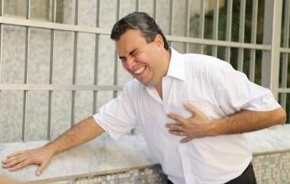
Chest Pain
Ask patient to sit down
Send someone to get an AED
Encourage them to take their medicine (if appropriate)

Slide 15
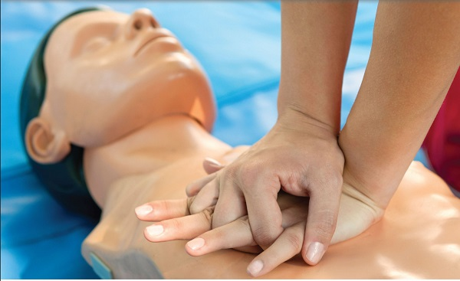
Cardiac Arrest
Check for signs of life
Call 911and send one to get AED
Compressions
https://www.youtube.com/watch?v=WpeMCS0cauI

Slide 16
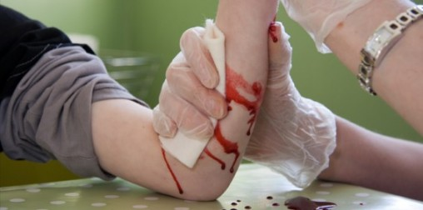
Bleeding
Put on gloves
Apply dressing to site of bleeding
If blood seeps through dressing, apply more on top of old
Consider use of tourniquet

Slide 17
Scenario 1
You are teaching on the third floor (AC or Hutto)
Students begin to smell smoke
You open the door to find the hallway filled with thick smoke at shoulder level.
BTW, you have a student who is in a wheelchair in your class.
What should you do?

Slide 18
Fire
Ensure that all students are physically capable of evacuating the building in a safe manner.
Remember that there may be persons who have invisible disabilities or have not disclosed their disability.
Remain with a person in the rescue area until relieved by police or fire personnel.
If the situation becomes life-threatening, vacate the building and notify the authorities ASAP
It becomes more difficult to rescue two people.
Meet at the designated gathering point.

Slide 19
Scenario 2
You are teaching in the AC or Hutto.
You notice a student who turns pale and begins to perspire. When you ask if he is alright, states that he has chest pain.
As you are deciding what you to do, he suddenly collapses in his chair.
What should you do?

Slide 20
To Consider
Not all students choose to disclose and most students have invisible disabilities
Students with conditions they consider stable can have flare ups with stress
Review emergency procedures with class at beginning of semester.

Slide 21
Contact Information
jeff.fritz@templejc.edu
tpechal@templetx.gov
jason.wilkinson@templejc.edu
Emergency Preparedness Week is second week of class.

